Slide 1
Pandemic Simulator
By: Connor Osborne and Benji Stewart

Slide 2

Buildings

Slide 3
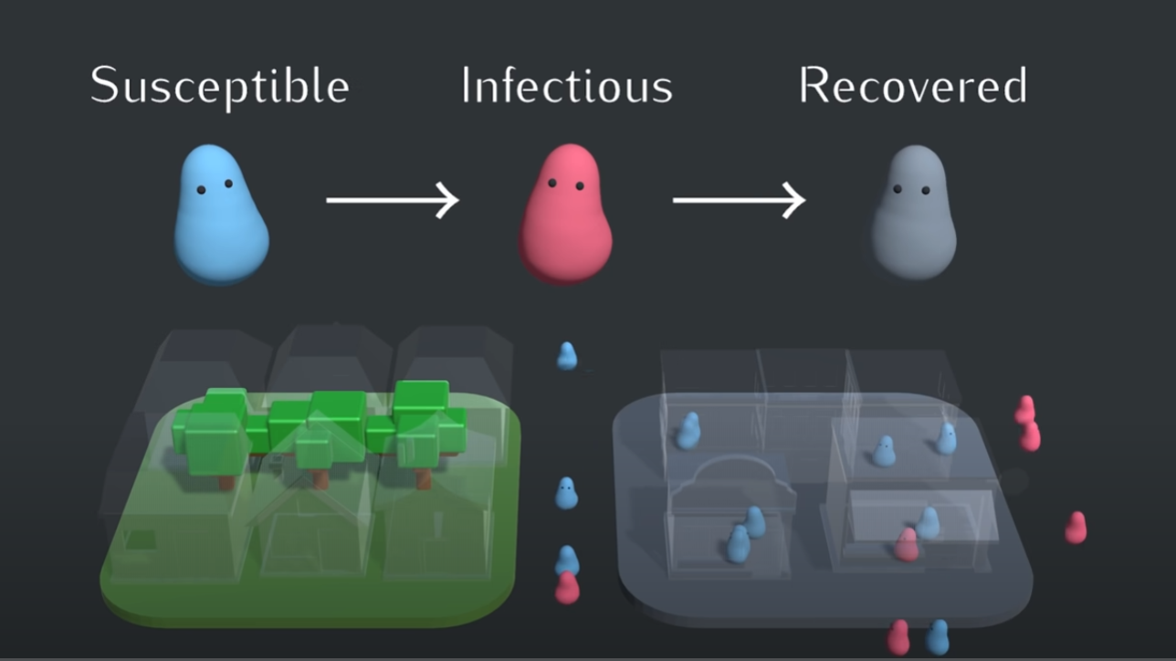
States for Each Person

Slide 4
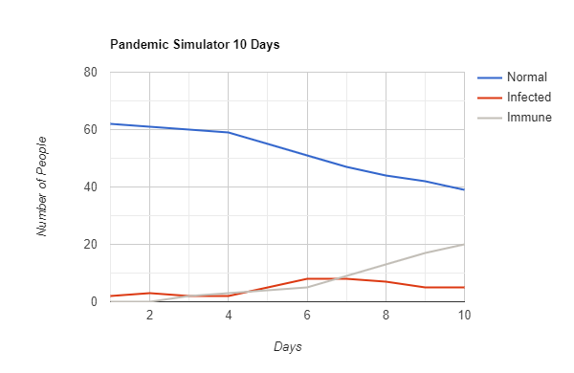
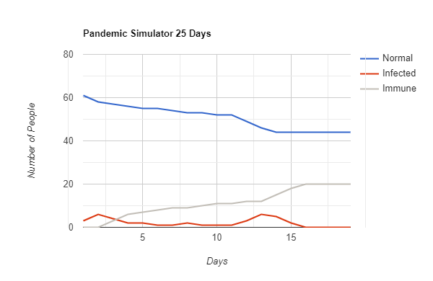
Results

Slide 5
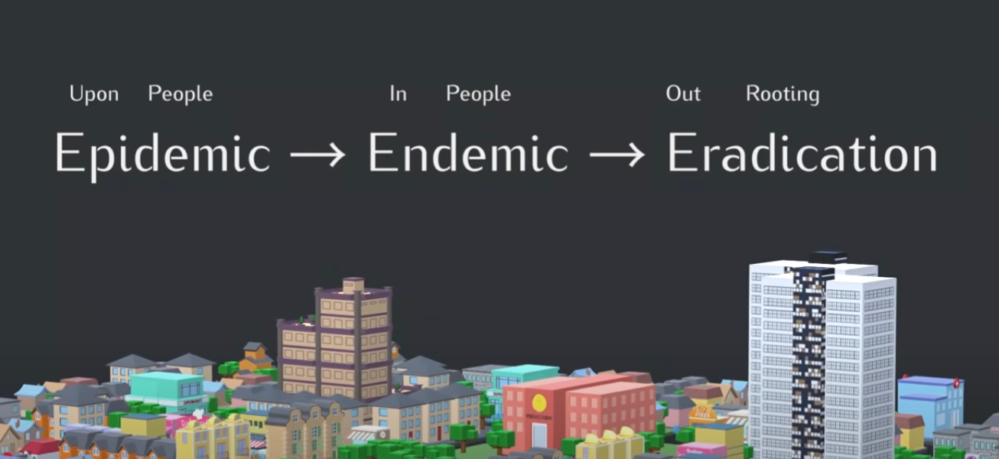
Acknowledgments
General Topic for this project came from:
Epidemic, Endemic, and Eradication Simulations
By: Primer

